Slide 1
.NET TRAINING SESSION

Slide 2
Contents
.NET Framework VS .NET Core
Collections
Generics

Slide 3
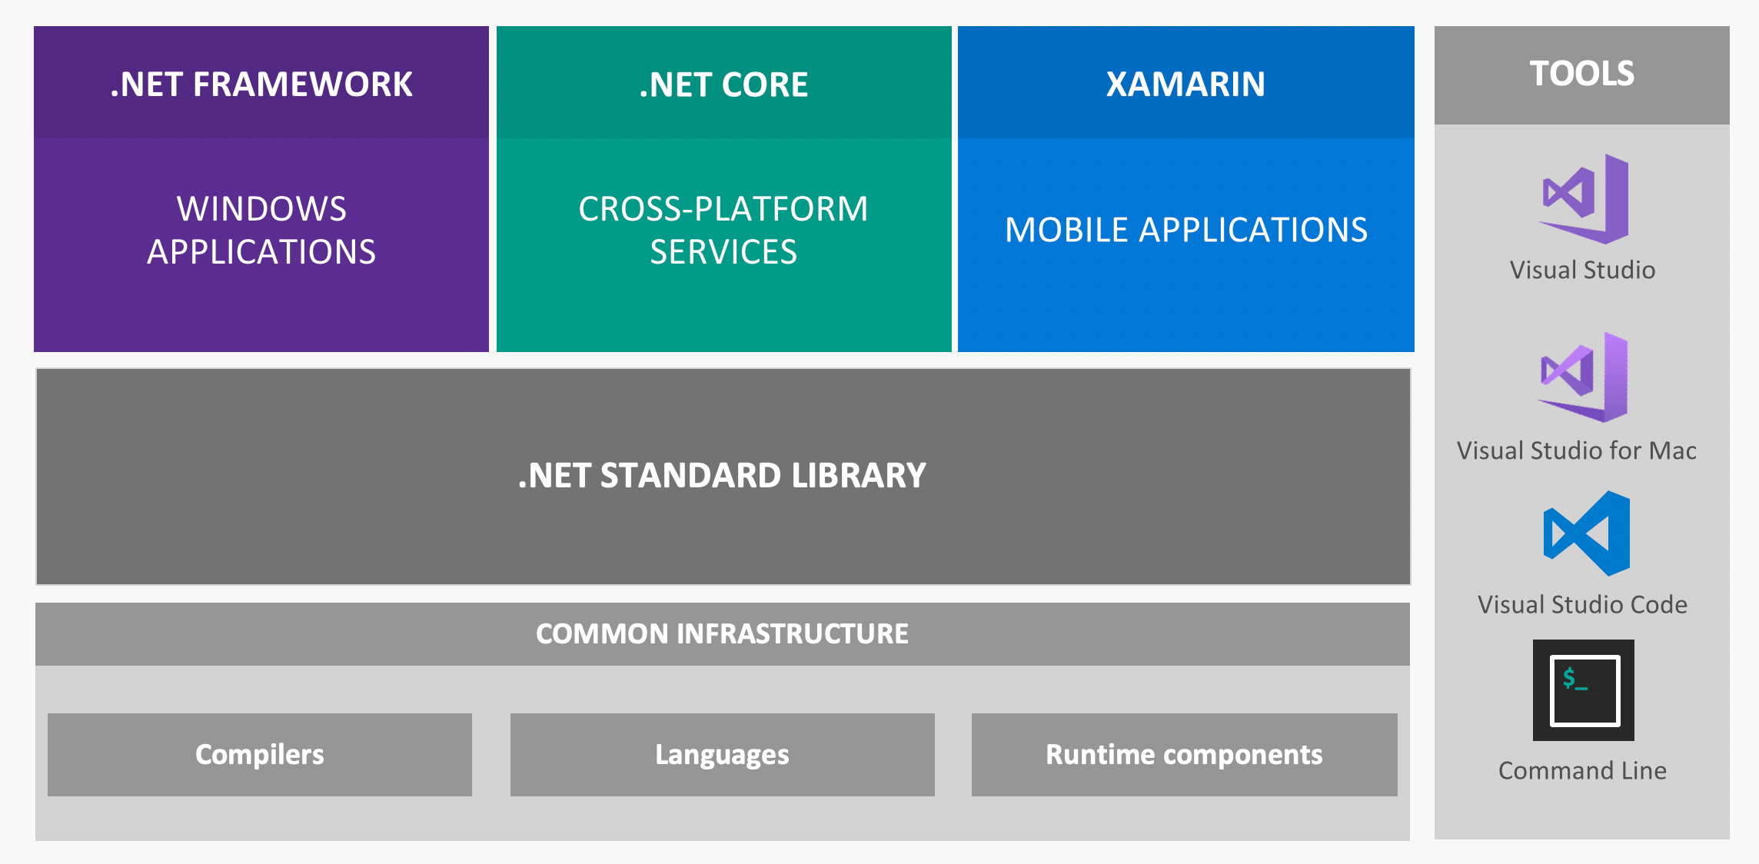
.NET Ecosystem

Slide 4
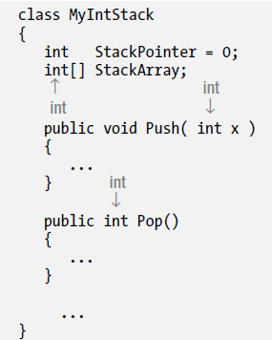
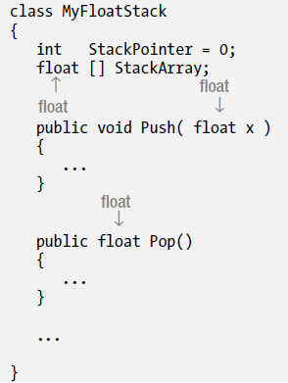
Generics
You can refactor your code and add an additional layer of abstraction so that the data types are not hard-coded.

Slide 5
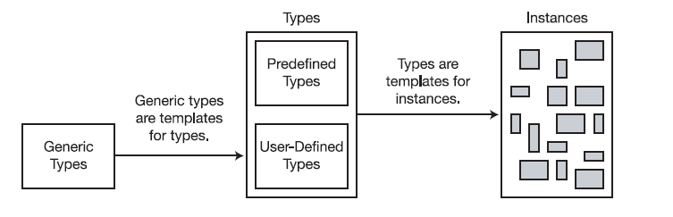
Generics allow you to declare type-parameterized code, which you can instantiate with different types. This means you can write the code with “placeholders for types” and then supply the actual types when you create an instance of the class.
You should be very familiar with the concept that a type is not an object but a template for an object. In the same way, a generic type is not a type but a template for a type.

Slide 6
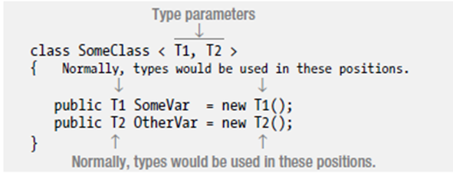
Declaring generic classes is done using the following guidelines:
Place a matching set of angle brackets after the class name.
Between the angle brackets, place a comma-separated list of the placeholder strings that represent the types, to be supplied on demand. These are called type parameters.
Use the type parameters throughout the body of the declaration of the generic class to represent the types that should be substituted in.

Slide 7
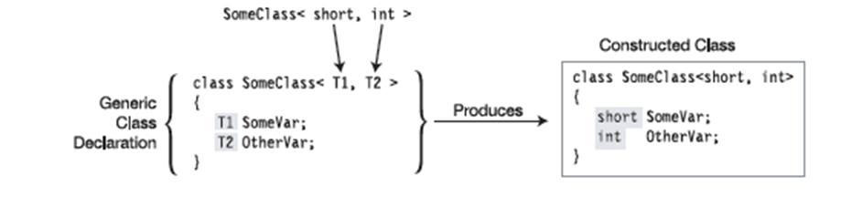
To construct a class type from a generic class, list the class name and supply real types between the angle brackets, in place of the type parameters.
The real types being substituted for the type parameters are called type arguments.
The compiler takes the type arguments and substitutes them for their corresponding type parameters throughout the body of the generic class, producing the constructed type—from which actual class instances are created.

Slide 8
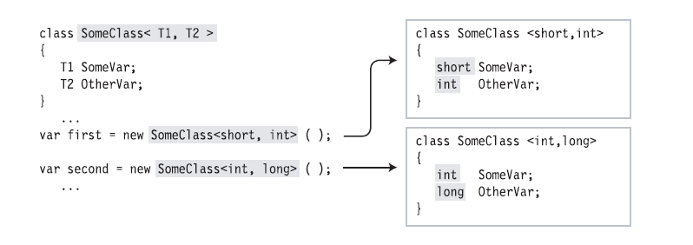
One class constructed with <Short, Int> and the other one with <Int, Short>

Slide 9
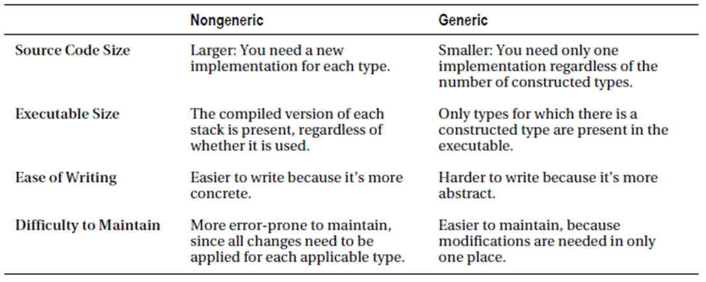

Slide 10
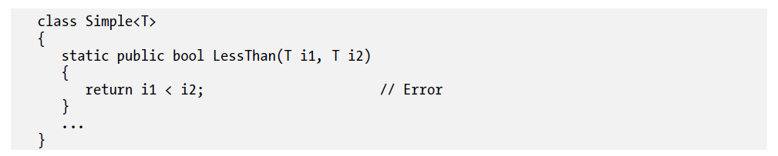

To make generics more useful, you need to be able to supply additional information to the compiler about what kinds of types are acceptable as arguments. These additional bits of information are called constraints. Only types that meet the constraints can be substituted for the given type parameter.
Constraints are listed as where clauses:
Each type parameter that has constraints has its own where clause
If a parameter has multiple constraints, they are listed in the where clause, separated by commas.

Slide 11
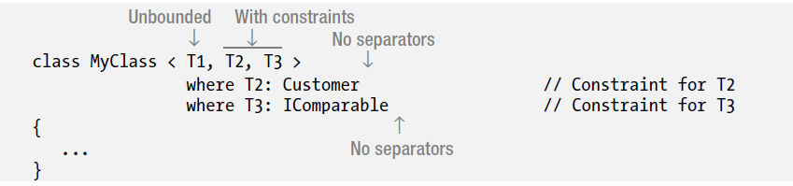
They’re listed after the closing angle bracket of the type parameter list
They’re not separated by commas or any other token
They can be listed in any order

Slide 12
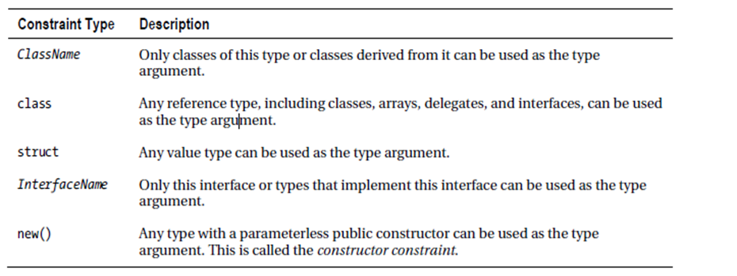
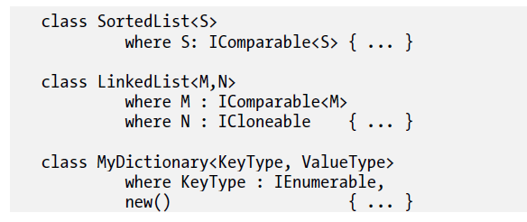
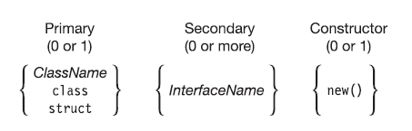

Slide 13
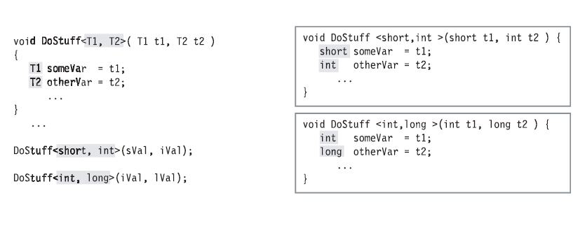
Unlike the other generics, a method is not a type but a member. You can declare generic methods in both generic and non-generic classes, and in structs and interfaces.
Generic methods have two parameter lists:
The method parameter list, enclosed in parentheses
The type parameter list, enclosed in angle brackets

Slide 14
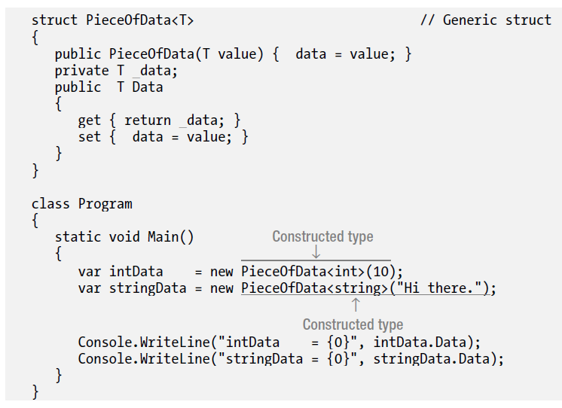
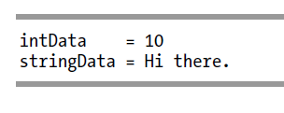
Like generic classes, generic structs can have type parameters and constraints.
The rules and conditions for generic structs are the same as those for generic classes

Slide 15
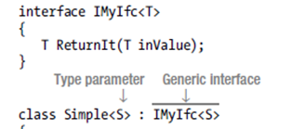


Generic interfaces allow you to write interfaces where the formal parameters and return types of interface members are generic type parameters.
Two additional capabilities of generic interfaces:
Like other generics, instances of a generic interface instantiated with different type parameters are different interfaces.
You can implement a generic interface in a non-generic type.

Slide 16
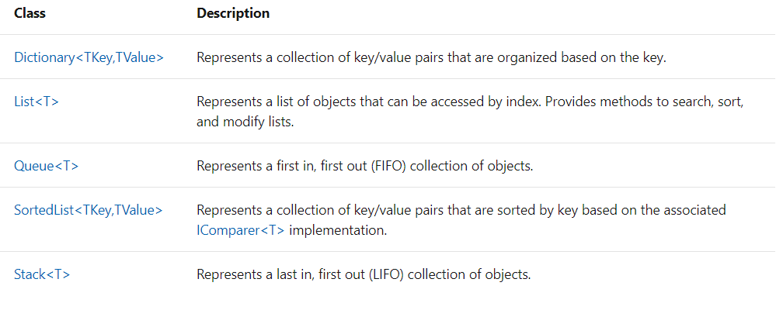
Collections
There are two ways to group objects: by creating arrays of objects, and by creating collections of objects
Unlike arrays, the group of objects you work with can grow and shrink dynamically as the needs of the application change
System.Collections namespace contains specialized classes for storing and accessing the data.

Slide 17
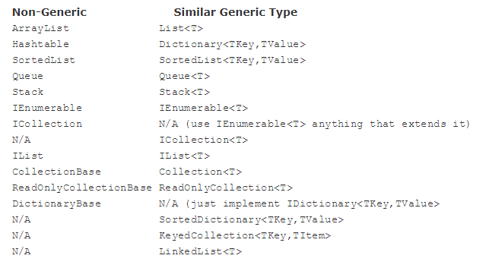

Slide 18
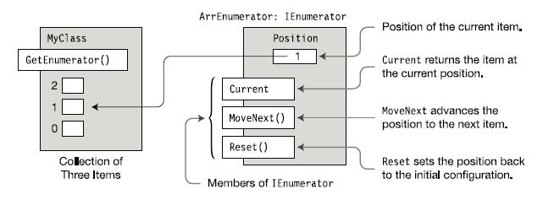
The enumerator is an object that can return each item in a collection, one by one in order, as they’re requested. The enumerator “knows” the order of the items and keeps track of where it is in the sequence. It then returns the current item when it is requested. An Enumerable is a type that has a method called GetEnumerator and that returns an enumerator, to retrieve its item.

Slide 19
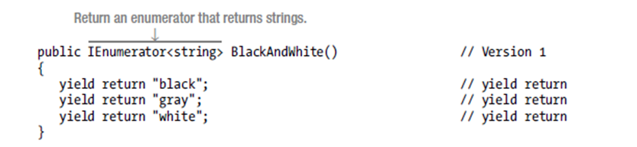
A much simpler way of creating enumerators and enumerables is to use an Iterator.
When you use the yield keyword in a statement, you indicate that the method, operator, or get accessor in which it appears is an iterator.
The yield return statement specifies the next item in the sequence to return.
The yield break statement specifies that there are no more items in the sequence.

Slide 20
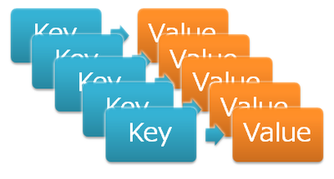
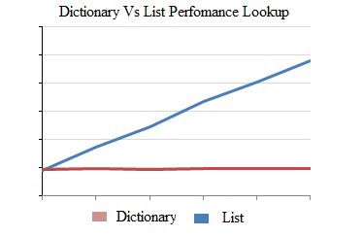
The Dictionary generic class provides a mapping from a set of keys to a set of values. Each addition to the dictionary consists of a value and its associated key. Retrieving a value by using its key is very fast, close to O(1), because the Dictionary class is implemented as a hash table.
Concurrent collections
System.Collections.Concurrent | Description
ConcurrentDictionary<TKey, TValue> | Represents a thread-safe collection of key/value pairs that can be accessed by multiple threads concurrently.
ConcurrentQueue<T> | Represents a thread-safe first in-first out (FIFO) collection.
ConcurrentStack<T> | Represents a thread-safe last in-first out (LIFO) collection.

